Slide 1
VR Controlled Robot
(VRCR)
Team Members: Eric Hinds, Levi McAdams, Zijian Song, Samuel Torres, and Tyler Allen

Slide 2

Team Introduction

Slide 3
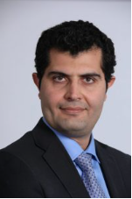
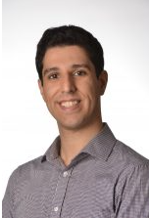

Project Clients
The clients for this project are Dr. Armin Eilaghi and Dr. Reza Razavian whom are both professors in the mechanical engineering department at NAU as well as CEIAS.
The funding for this project is supplied by CEIAS.
(figures 3, 4,5)
Figure 3. Dr. Armin Eilaghi
Figure 4. Dr. Reza Razavian
Figure 5. Ceias
Samuel Torres 06/20/23 VRCR 13

Slide 4
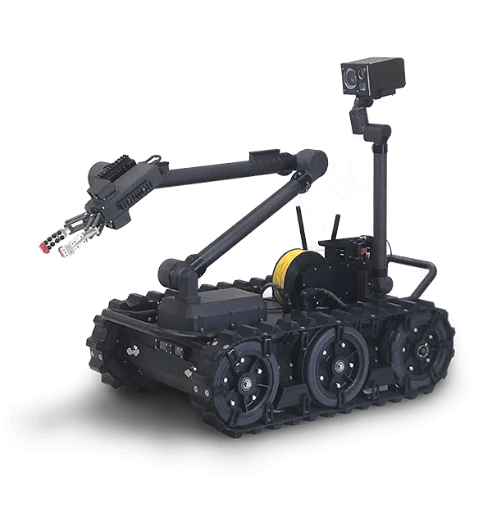
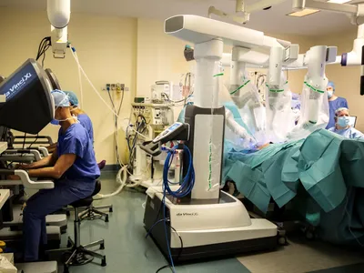
Project Description
Robotic Utility Tank’s (RUT) are great for performing tasks where a human cannot or should not be present such as:
Explosive environments
Surgery from a different place
Space exploration
[1] Figure 6: Military Robot
[2] Figure 7: Surgery Robot
[1] https://justtotaltech.com/military-robots/
[2] https://spectrum.ieee.org/robotic-surgery
Levi McAdams
7/3/23 VRCR 23

Slide 5
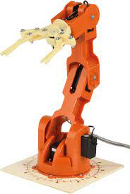
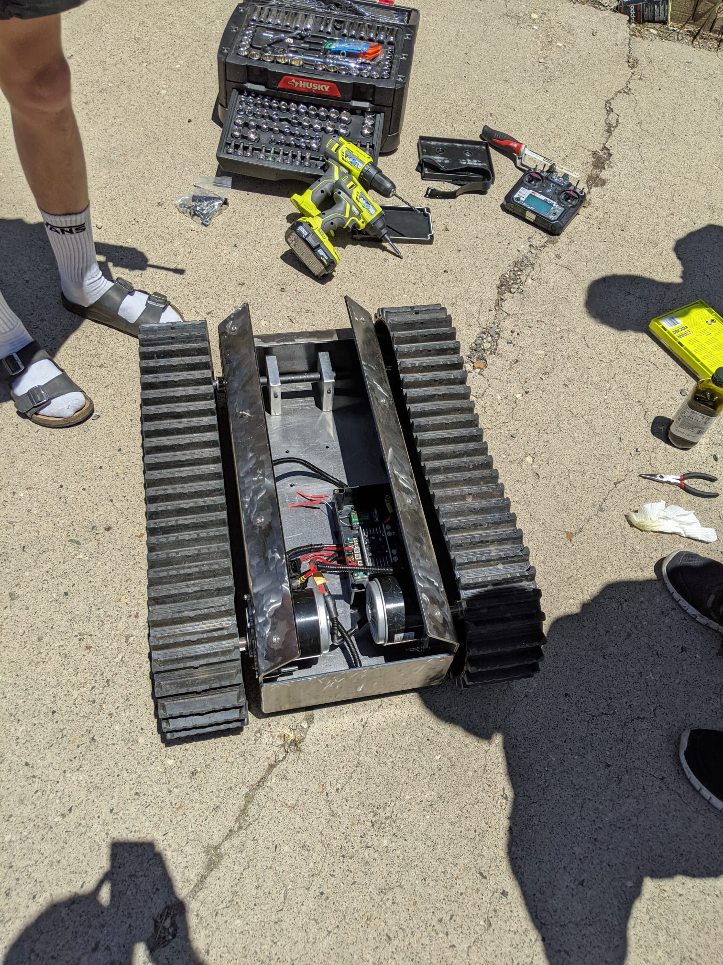
Project Description
VR Controlled Robot (VRCR)
Integrate
Controlled
by
VR
Figure 9 Robot Arm
https://store-usa.arduino.cc/products/tinkerkit-braccio-robot?selectedStore=us
Figure 8 RUT
Courtesy of Samuel T.
Samuel Torres 06/20/23 VRCR

Slide 6
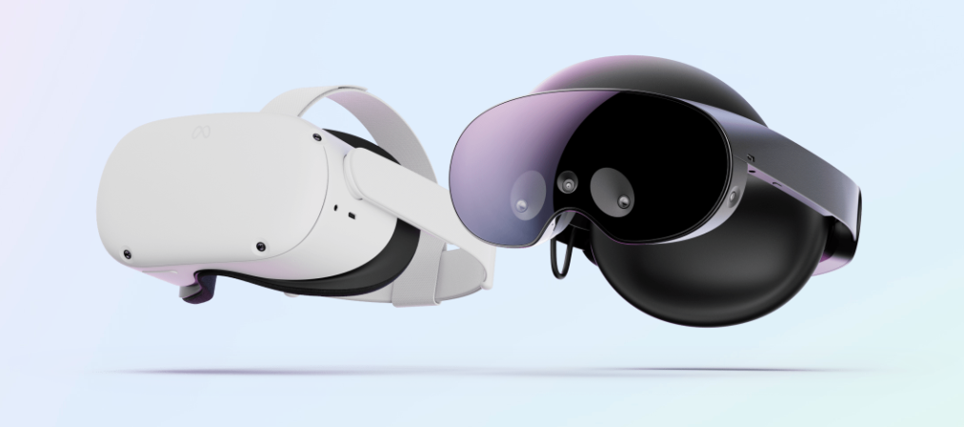
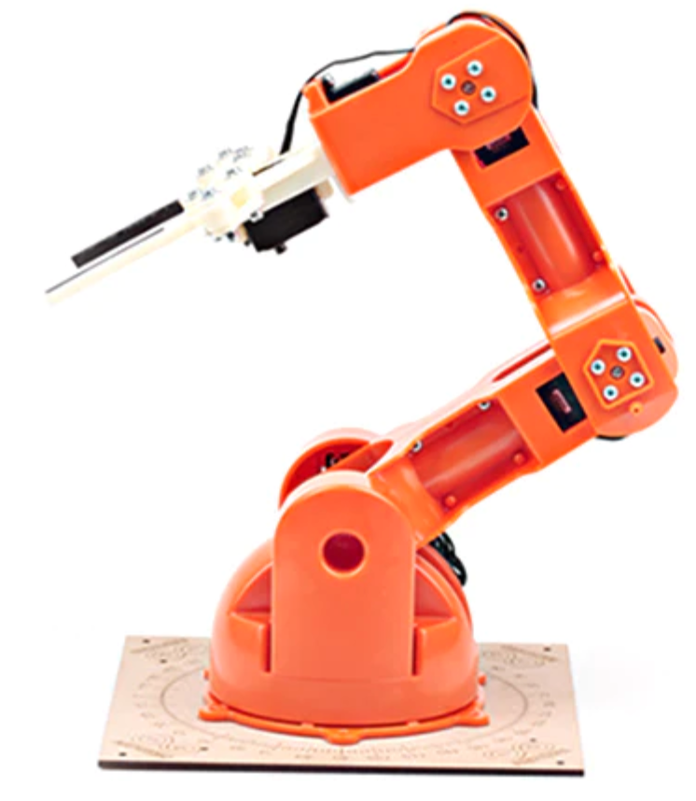
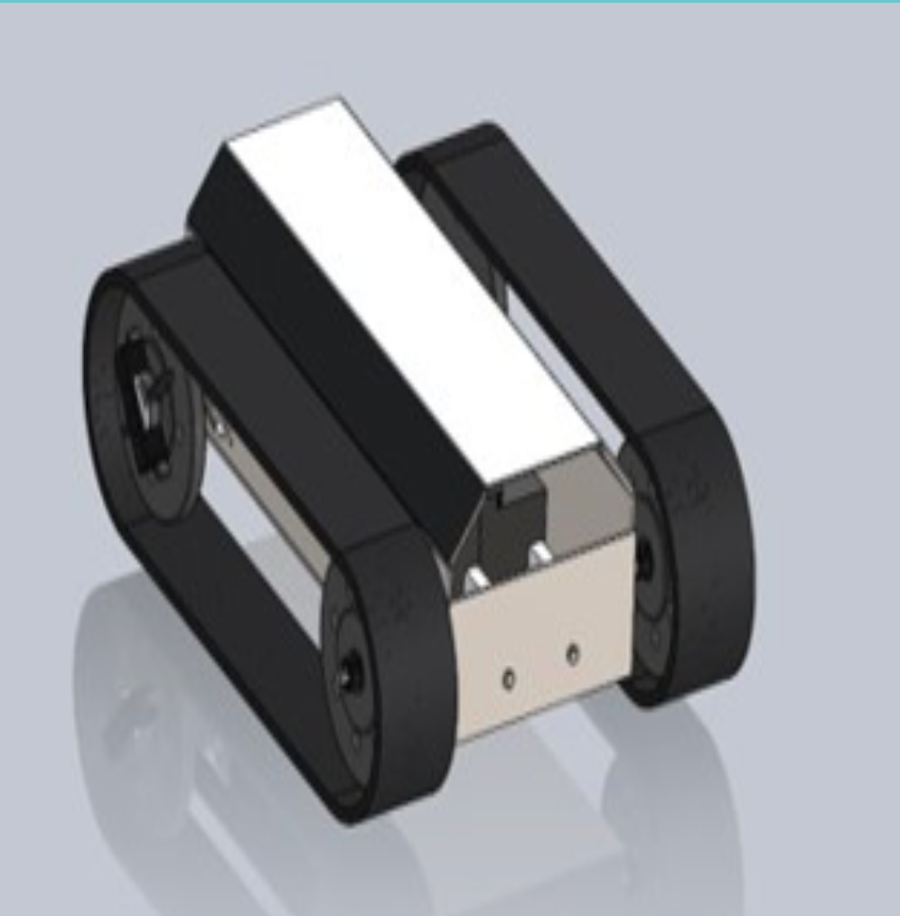
Concept Generation Process
RUT
Robot Utility Tank provided by a previous capstone
Customer requirements request mobility improvements
Robotic Arm
Team was able to decide direction
Purchase a pre built example
Design one from scratch
VR Control
Meta Quest 2
Figure 12 Meta Quest 2
Figure 11 Robot Arm
[3] https://www.meta.com/quest/products/quest-2/
Figure 10 RUT
[2] https://store-usa.arduino.cc/products
/tinkerkit-braccio-robot?selectedStore=us
[1] https://www.ceias.nau.edu/capstone/projects/ME/2022/22Spr01_RobotRE/
Levi McAdams 07/03/23 VRCR 23

Slide 7
Design Options
Two Arms
Pros: Larger work area and Precision movements
Cons: Complex coding, complex controls
Multiple 2D Camera
Pros: Different viewing angles
Cons: Complex coding, calibration, and design
Single 3D Camera
Pros: Simple programing of depth, purpose built
Cons: Lack of viewing angles
Single Arm
Pros: Simple controls and integration
Cons: Smaller work space and lack of movement
Levi McAdams 07/03/23 VRCR 23

Slide 8
Design Criteria
Move in 3D: Enable working in a 3D space
Large Workspace: High working range over 0.5m
High-resolution sensing: Summary of latency due to computing and signal transmitting lower than 40ms
Accurate VR control: Error of travelling distance within 5% for the first trial of move
Easy to use: Operable for a common user without specific training
Tyler Allen 07/03/23 VRCR

Slide 9
Pugh Chart
Customer Requirements | Weight | One-arm 2D Camera | One-arm 3D Camera | Two-arm 2D Camera | Two-arm 3D Camera
Move in 3D | 4 | S | + | S | +
Large Workspace | 4 | S | S | ++ | ++
High-resolution Sensing | 3 | S | S | S | -
Accurate VR control | 5 | S | + | - | S
Easy to use | 4 | S | S | - | -
Total + |  | 0 | 4 | 1 | 2
Total S |  | 5 | 1 | 2 | 0
Total - |  | 0 | 0 | 2 | 3
Total |  | 0 | 9 | -1 | 5
Tyler Allen 07/03/23 VRCR

Slide 10
Decision Matrix
Table 1: Decision Matrix
Customer Requirements | One-arm 2D Camera | One-arm 3D Camera | Two-arm 2D Camera | Two-arm 3D Camera
Move in 3D | 3 | 4 | 3 | 4
Large Workspace | 3 | 3 | 4 | 4
High-resolution Sensing | 3 | 4 | 3 | 4
Accurate VR control | 4 | 5 | 2 | 3
Easy to use | 4 | 4 | 2 | 2
Total | 17 | 20 | 14 | 17
Tyler Allen 07/03/23 VRCR

Slide 11
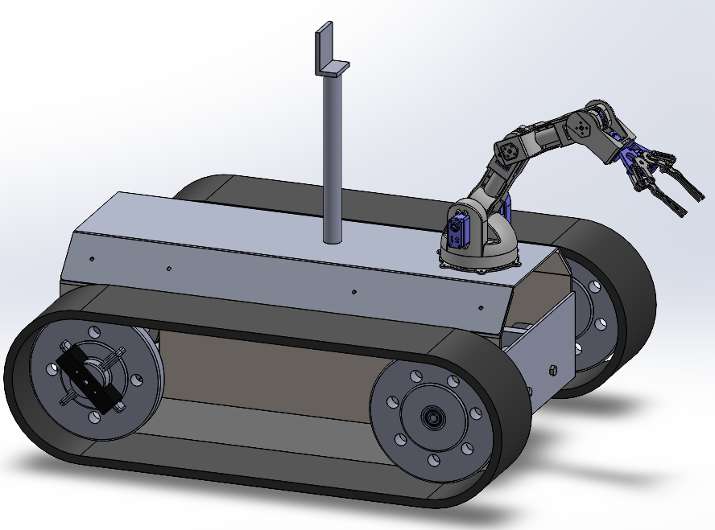
Best Design
One arm with a 3D camera was found to be the best concept design
To ensure adequate workspace for the single arm it will be mounted near the front of RUT
The 3D camera will be mounted up high on a post to give a good view of the arm, workspace, and the area ahead
Figure 13: Best Concept Design
Zijian Song 07/03/2023 VRCR

Slide 12
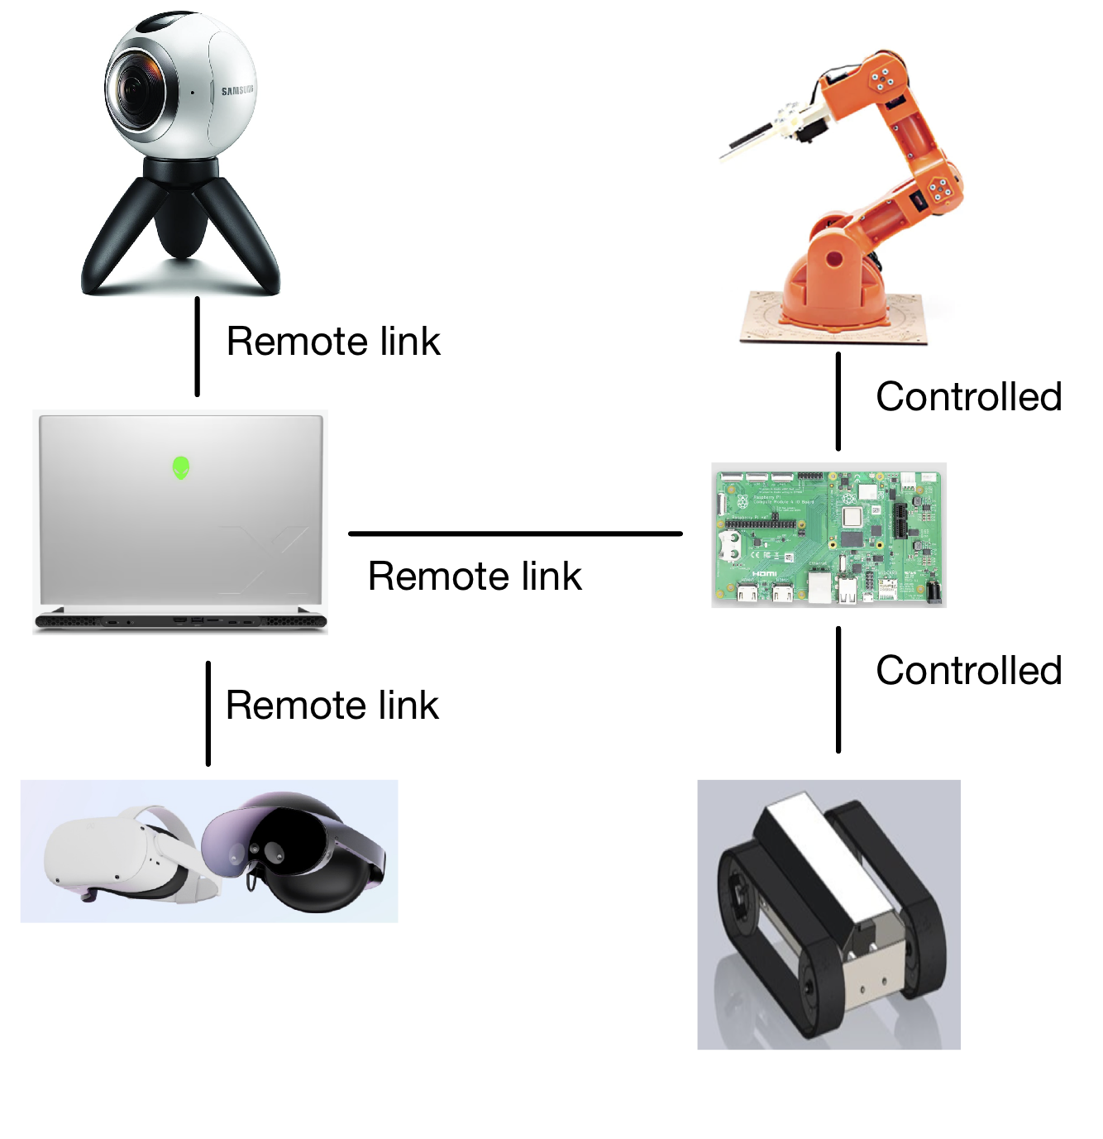
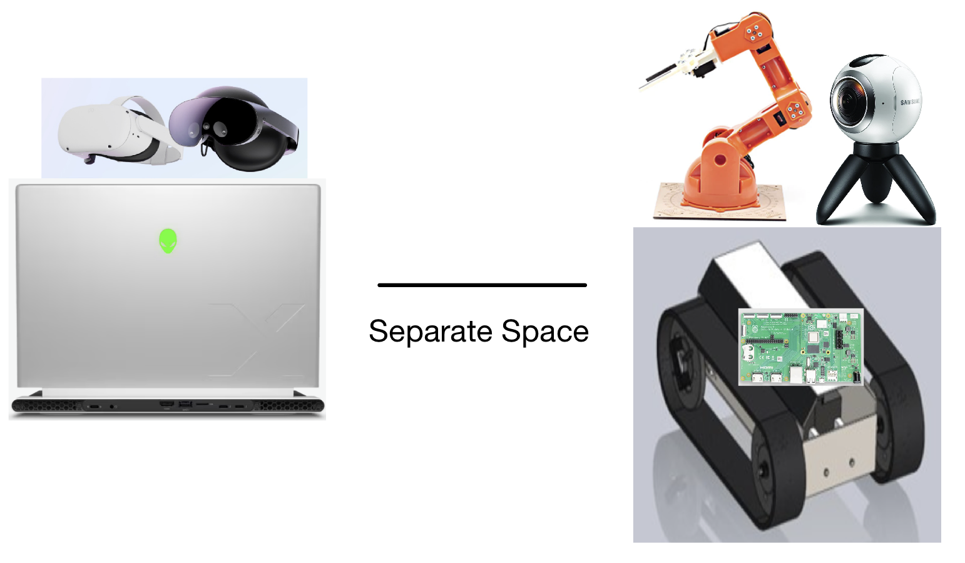
Interfacing of Parts
Figure 15: Space Relationship
Figure 14: Link Relationship
[4]https://store-usa.arduino.cc/products/tinkerkit-braccio-robot?selectedStore=us
[5]https://www.ceias.nau.edu/capstone/projects/ME/2022/22Spr01_RobotRE/
[6]https://www.meta.com/quest/products/quest-2/
[7]https://www.dell.com/en-us/shop/gaming-pcs-and-accessories/alienware-x14-gaming-laptop/spd/alienware-x14-r2-laptop/useahctox14r2rpl01
[8]https://www.raspberrypi.com/
[9]https://www.amazon.com/Samsung-Resolution-Camera-Version-Warranty/dp/B01D9LVL3G/ref=sr_1_15?hvadid=153690422625&hvdev=c&hvlocphy=1013406&hvnetw=g&hvqmt=e&hvrand=4284263521118535615&hvtargid=kwd-74069108&hydadcr=11662_9371252&keywords=vr+camera&qid=1688439191&sr=8-15&ufe=app_do%3Aamzn1.fos.f5122f16-c3e8-4386-bf32-63e904010ad0
Zijian Song 07/03/23 VRCR

Slide 13
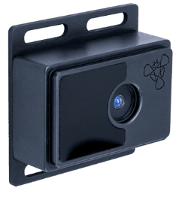
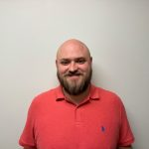
VR / Camera Update
Further perfection of headset integration to Unity.
Tweaks in settings, etc.
Requirements for wireless camera connection:
Wifi Enabled
SDK or API streaming
Only requirements for Unity
Stream video and depth data
Successfully located a likely camera to be used within the project.
Terabee 3DCam
Communication with NAU Software Engineer Cole Pendergraft
[11] Figure 16: Terabee 3DCam
[10] https://learn.unity.com/tutorial/working-with-unity-cameras-questions#
[11] https://docs.unity3d.com/Packages/com.unity.renderstreaming@3.1/manual/video-streaming.html
[12] https://www.terabee.com/shop/3d-tof-cameras/terabee-3dcam/
[13] https://nau.edu/ceias/staff-who-does-what/
[12] Figure 17: Cole Pendergraft
Eric Hinds 07/03/23 VRCR

Slide 14
Bill Of Materials 1/2
Green
Signifies successful purchase.
Red
Signifies units that the team has decided against.
Yellow
Signifies loaners, or other units that are needing to be bought.
BOM Level | P/N | Part Name | Description | Qty | UOM | Price | Exporter | Purchased Y/N
1 | T05000 | Tinkerkit Braccio Robot | A fully operational robotic arm, of which the team has had practice using thanks to generous loaners from the school. | 1 | Each | $100.99 | Arrow | Yes
1 | 899-00182-02 | Oculus Quest 2 | Fully immersive VR headset and controllers. Built for ease of use, and wifi connection friendly. | 1 | Each | $299.99 | Walmart / Target | Loaned
1 | OS30A | YDLIDAR 3D Depth Camera | 3D camera used to impliment 3D tracking into the Unity game (for VR integration). | 1 | Each | $139.00 | YDLIDAR | No
Table 2: Bill of Materials
Eric Hinds 07/03/23 VRCR 12

Slide 15
Bill of Materials 2/2
Green
Signifies successful purchase.
Red
Signifies units that the team has decided against.
Yellow
Signifies loaners, or other units that are needing to be bought.
1 | TB-3DCAM-8060-USB | Terabee 3Dcam 80x60 | 3D Camera capable of streaming depth and video footage. This camera is also compatible with direct python interaction, and pre existing softwares for ease of use. | 1 | Each | $250.00 | Terabee | No
2 | SC15184 | Raspberry Pi 4 | Small, single board computer designed as a means to connect everything in the project together. | 1 | Each | $69.90 | Amazon | No
2 | M-C2Y-DS13 | Matterhack Pro Series PLA Filament | 1kg Spool of Matterhackers PRO series PLA filament for 3D printing at home. | 1 | Each | $62.23 | Matterhackers | Yes
Table 2: Bill of Materials
Eric Hinds 07/03/23 VRCR 12

Slide 16
Budget
 | Expenses To Date | Description
 | $610 | Cost/Value of the RUT
 | $117 | Cost/Value of the Braccio Robot
 | $63 | Cost of a single spool of filament.
Total | $790
The current budget may be increased if more funds are approved by the department or by applying for funding from GORE.
Table 3: Expense Calculations
Current Budget | Expenses To Date | Future Expenses | Extra
$2,000 | $790 | $600 | $610
Table 4: Complete Budget
[13] Gore | Improving lives through advanced materials,” Gore.com, 2015. https://www.gore.com/
Eric Hinds 07/03/23 VRCR 13

Slide 17
Thank You
14

Slide 18
Questions?
16

Slide 19
References
[1] https://www.ceias.nau.edu/capstone/projects/ME/2022/22Spr01_RobotRE/
[2] https://www.meta.com/quest/products/quest-2/
[3]https://store-usa.arduino.cc/products/tinkerkit-braccio-robot?selectedStore=us
[4]https://www.ceias.nau.edu/capstone/projects/ME/2022/22Spr01_RobotRE/
[5]https://www.meta.com/quest/products/quest-2/
[6]https://www.dell.com/en-us/shop/gaming-pcs-and-accessories/alienware-x14-gaming-laptop/spd/alienware-x14-r2-laptop/useahctox14r2rpl01
[7]https://www.raspberrypi.com/
[8]https://www.amazon.com/Samsung-Resolution-Camera-Version-Warranty/dp/B01D9LVL3G/ref=sr_1_15?hvadid=153690422625&hvdev=c&hvlocphy=1013406&hvnetw=g&hvqmt=e&hvrand=4284263521118535615&hvtargid=kwd-74069108&hydadcr=11662_9371252&keywords=vr+camera&qid=1688439191&sr=8-15&ufe=app_do%3Aamzn1.fos.f5122f16-c3e8-4386-bf32-63e904010ad0
[9] https://learn.unity.com/tutorial/working-with-unity-cameras-questions#
[10] https://docs.unity3d.com/Packages/com.unity.renderstreaming@3.1/manual/video-streaming.html
[11] https://www.terabee.com/shop/3d-tof-cameras/terabee-3dcam/
[12] https://nau.edu/ceias/staff-who-does-what/

Slide 20
Potential Questions 1

Slide 21
Potential Questions 2

Slide 22
Potential Questions 3

Slide 23
Potential Questions 4

Slide 24
Potential Questions 5

